Slide 1
Impact of Customer Preferences on Home Rentals
Shaivi Kharbikar_Data Science_IIIT B_Upgrad

Slide 2
Agenda
Objective
Background
Key Findings
Recommendations
Appendix:
Data Attributes
Data Methodology
Data Assumptions

Slide 3
Objective
Improve our shared understanding about the market conditions
Improve shared understanding about our customers
Provide recommendation to various departments to be prepared for the changes post pandemic

Slide 4
Background
Major decline in revenues due to pandemic in the last few months
Restriction are lifting
People are travelling more

Slide 5
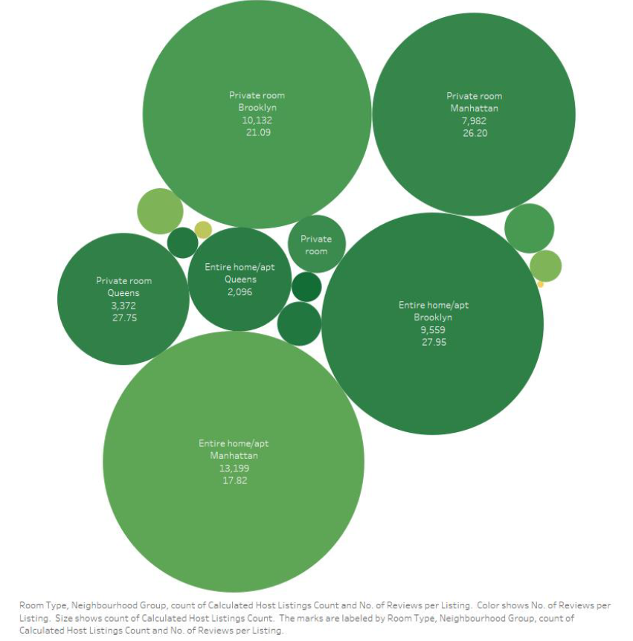
Neighbourhood Wise Business Distribution
Private rooms are the most popular throughout New York >25 reviews per listing
Entire home/apt in Manhattan has reviews per listing 35% less than the average of 27.7
Except Manhattan, all areas performed poorly in shared rooms with an average of 7.3 reviews per listing

